Slide 1

Final Presentation
Dawn Eggleton, Kalia Hameiri, Omar El Tayara, and Yousef Abdel-Rahman

Slide 2
Overview
Concept
Features
Development
Assets
Demo

Slide 3
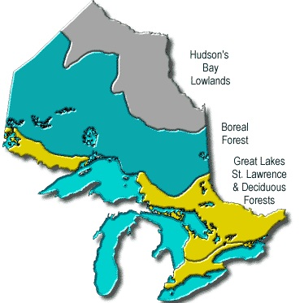
Concept
Nature hike through Ontario’s three major biomes:
Deciduous Forest
Boreal Forest
Wetlands

Slide 4
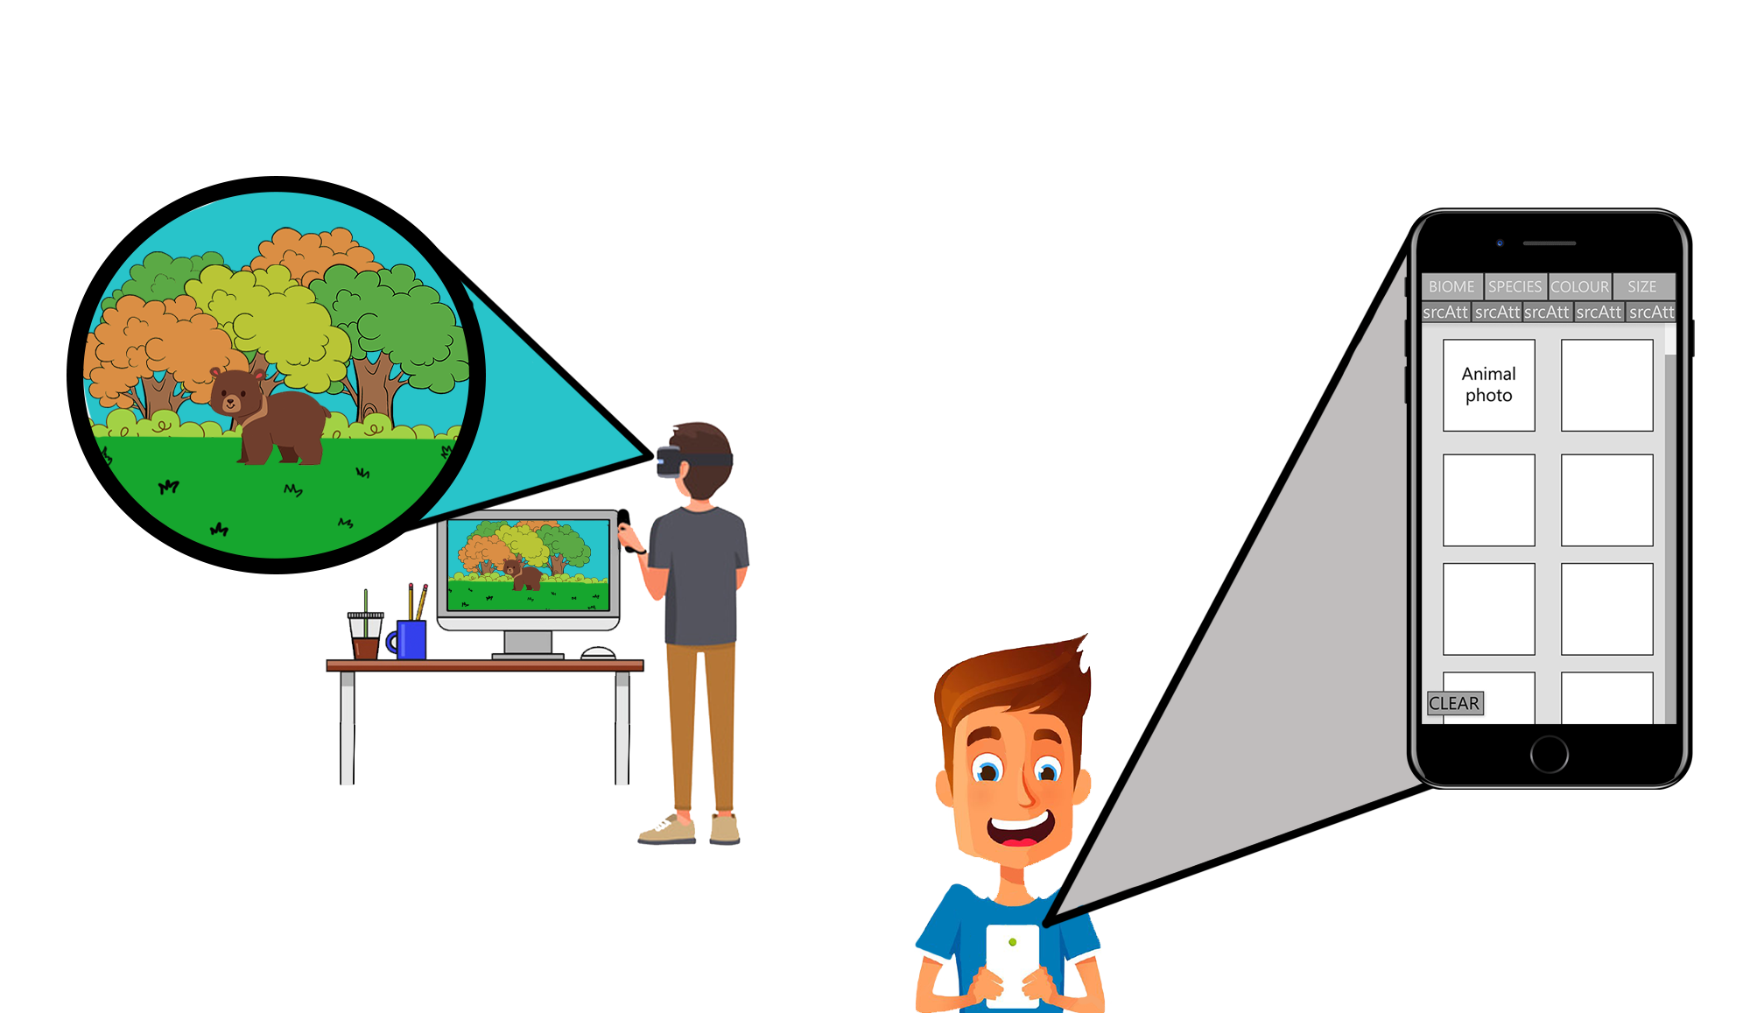
Concept
Cooperation
Guide can see the actions for each animal
Hiker can see the animal and the available options
Must work together to determine the correct action

Slide 5
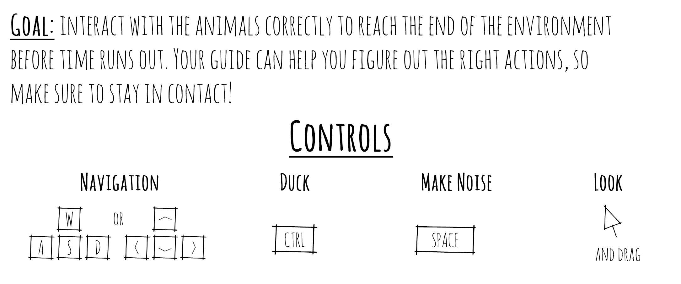
Concept
Challenge
7 animal interactions
5 minute maximum
Must get through all 7 animals to be entirely successful

Slide 6
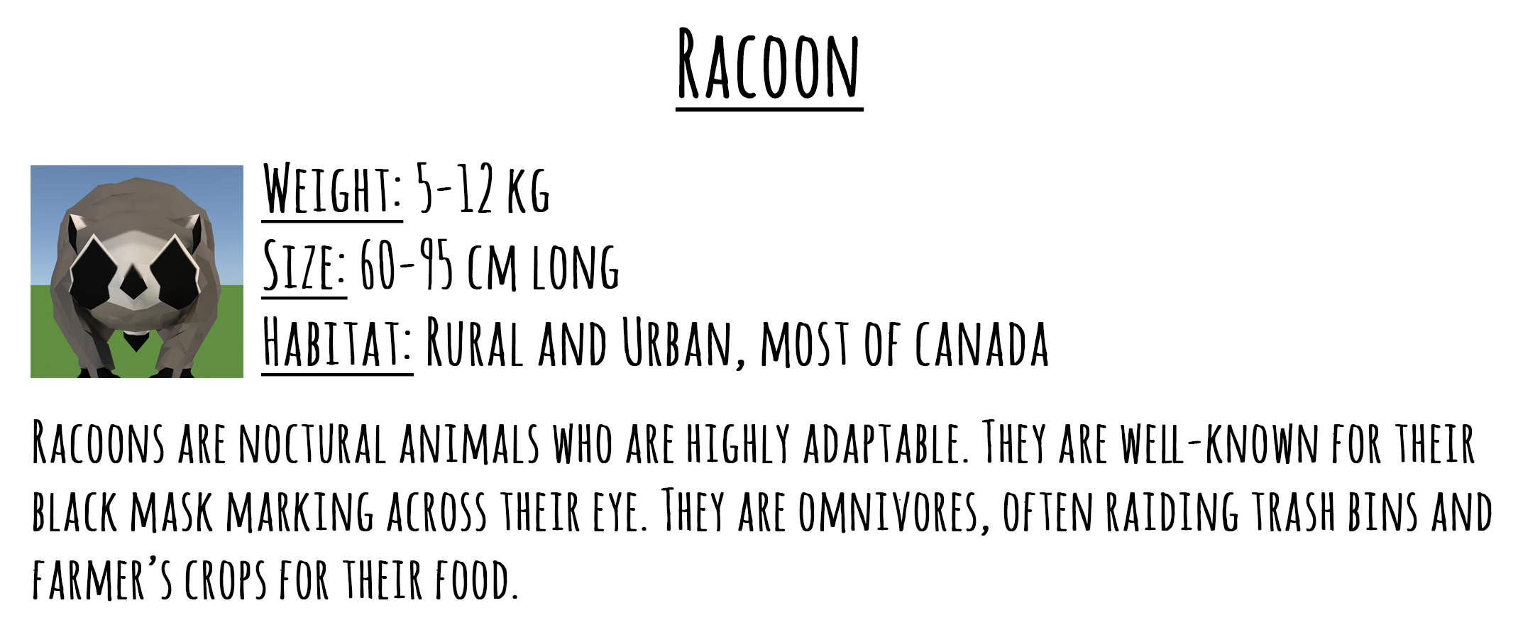
Concept
Educational
During hike, 3D to-scale models are presented to the hiker, and images with textual data to the guide
After the hike, animal information cards are presented to the hiker with more information

Slide 7
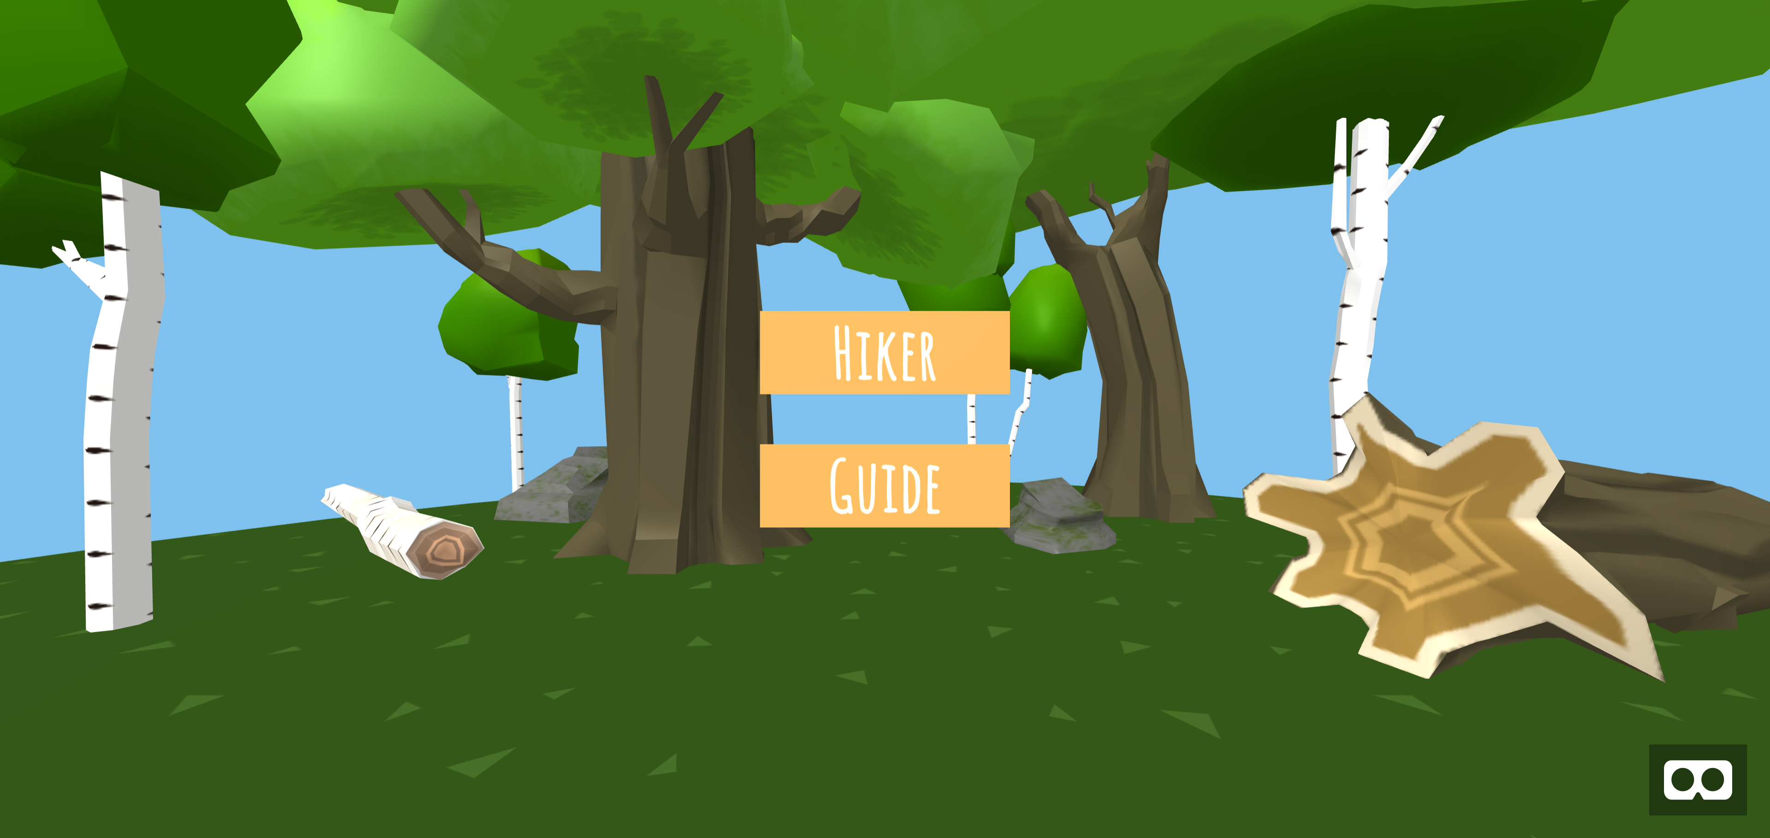
Features
Selection Screen
Features models from the two forest biomes
Selection of Hiker or Guide

Slide 8
Features
Guidebook
Desktop or mobile – vertical or horizontal
Filter by biome, species, color, and size

Slide 9
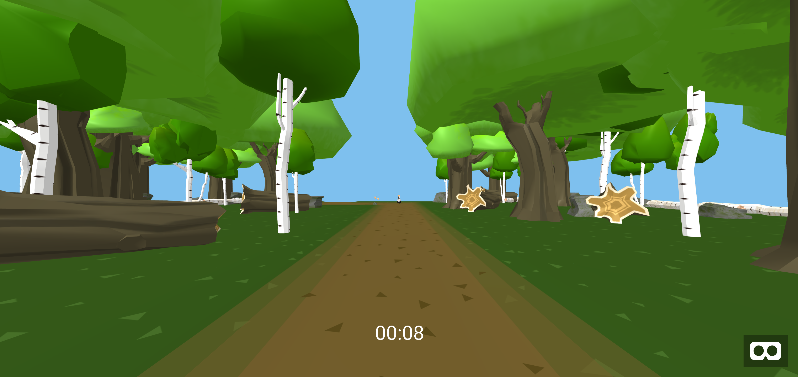
Features
Hiking Screen
Limited to on or near the path
Procedural generation of environment models and sounds
Random, biome-specific animal generation
Buffered environment

Slide 10
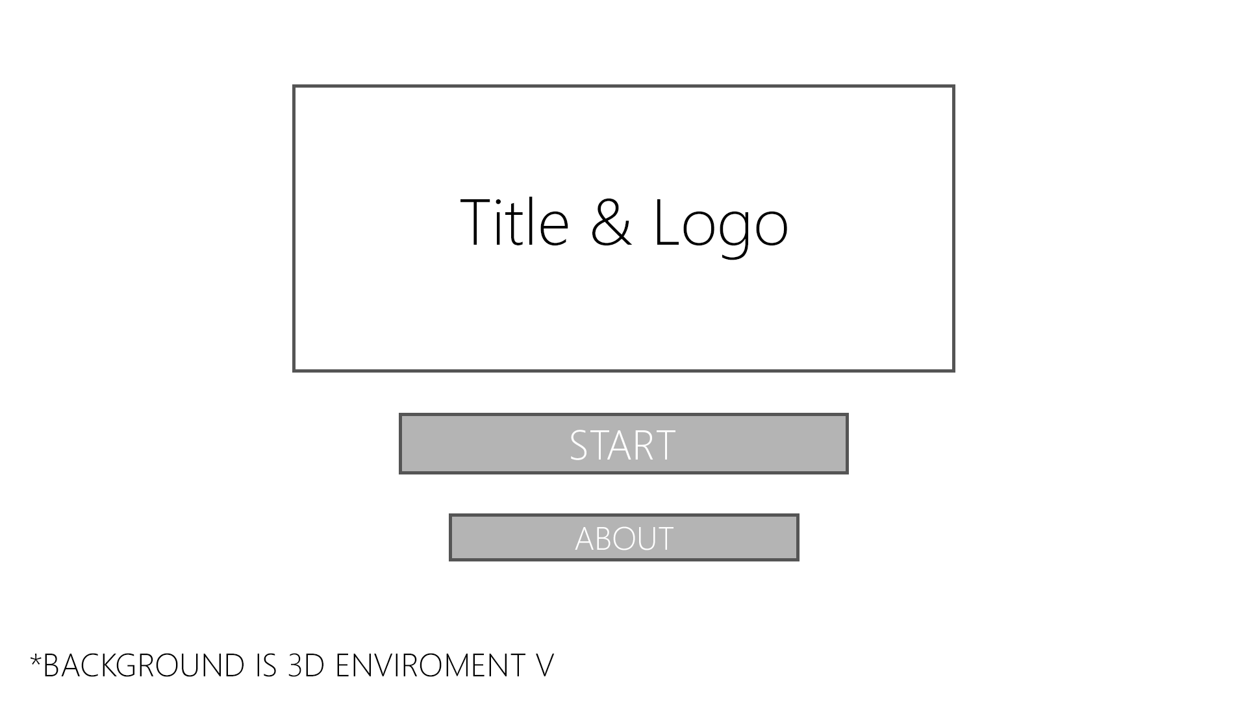

Development
Selection Screen – Then vs Now

Slide 11
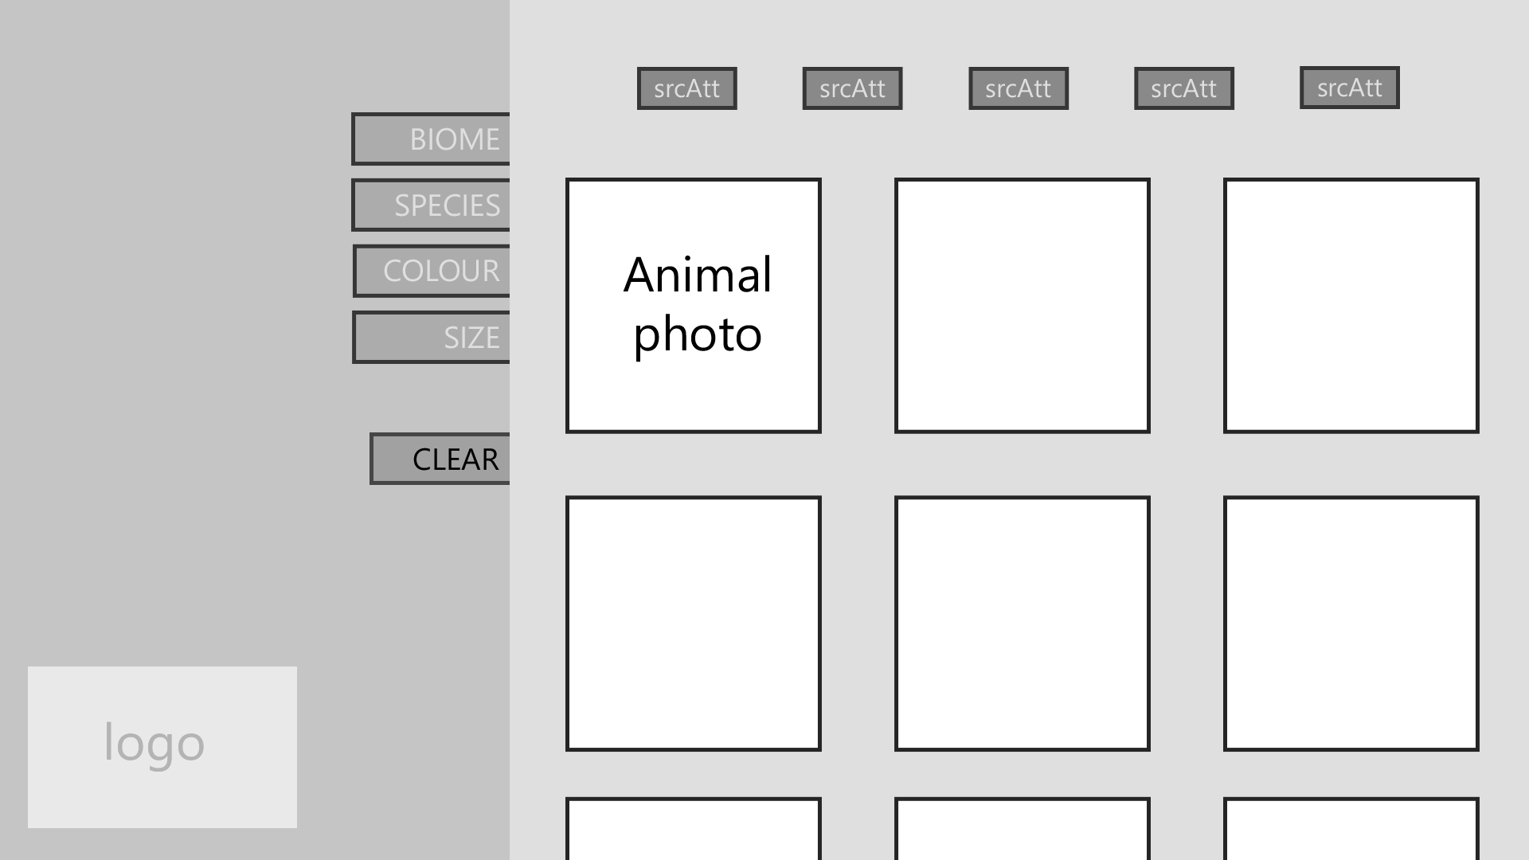
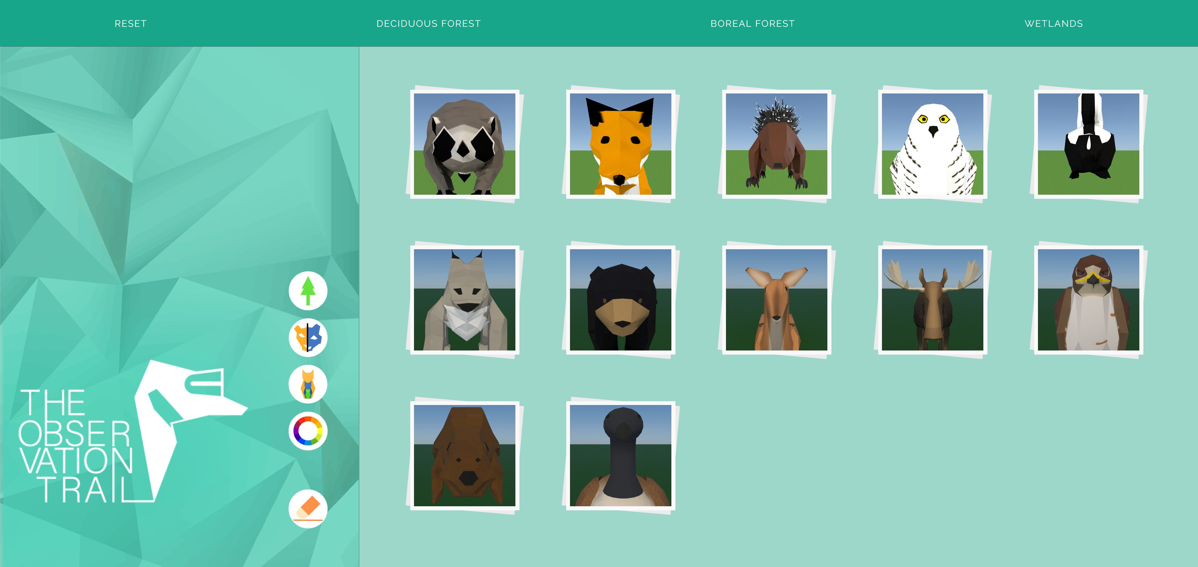
Development
Guidebook – Then vs Now

Slide 12
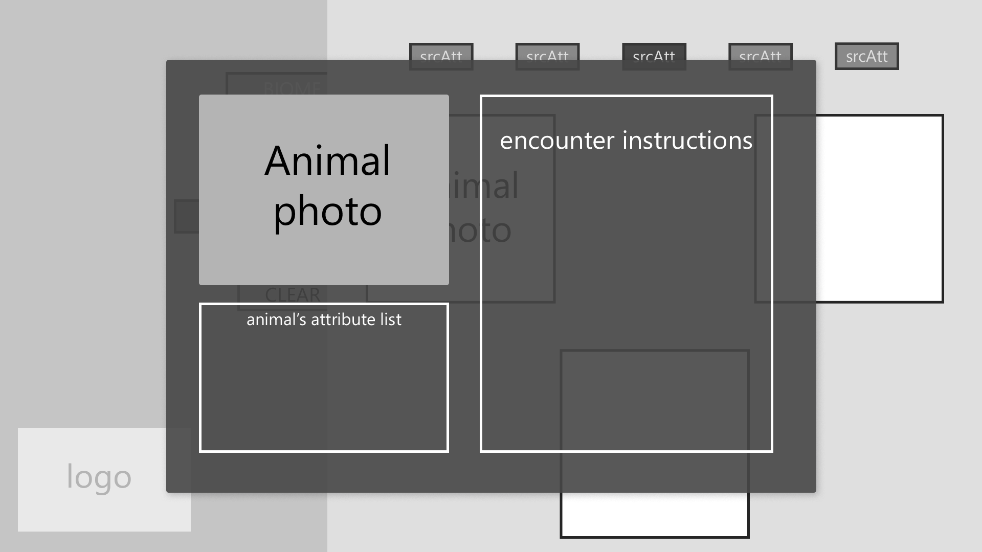
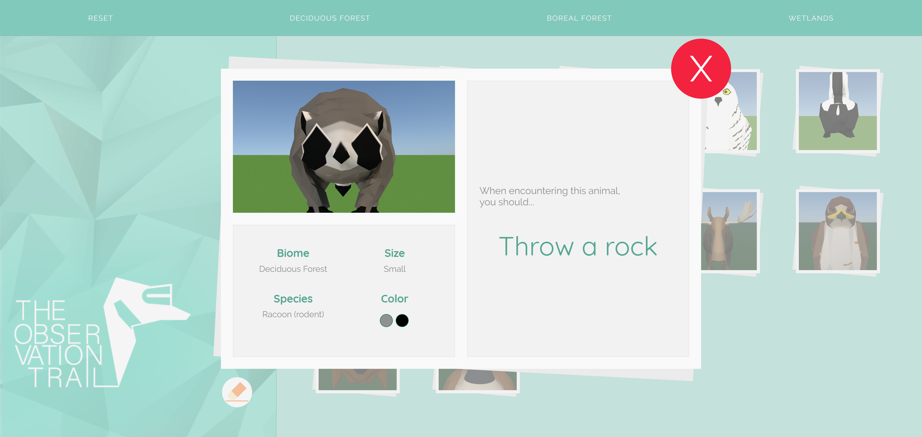
Development
Guidebook – Then vs Now

Slide 13
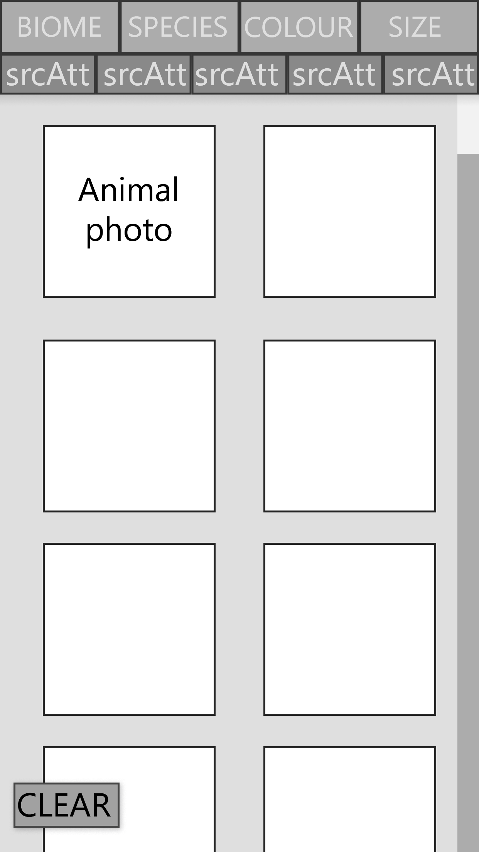
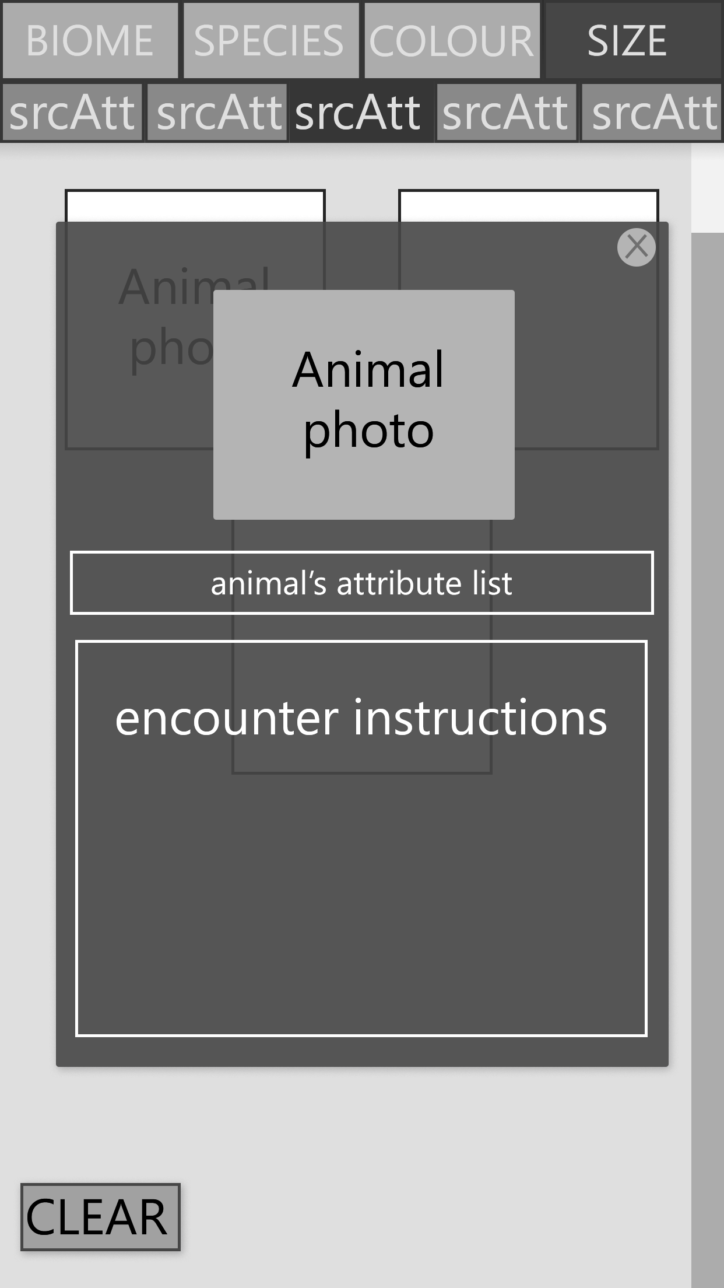
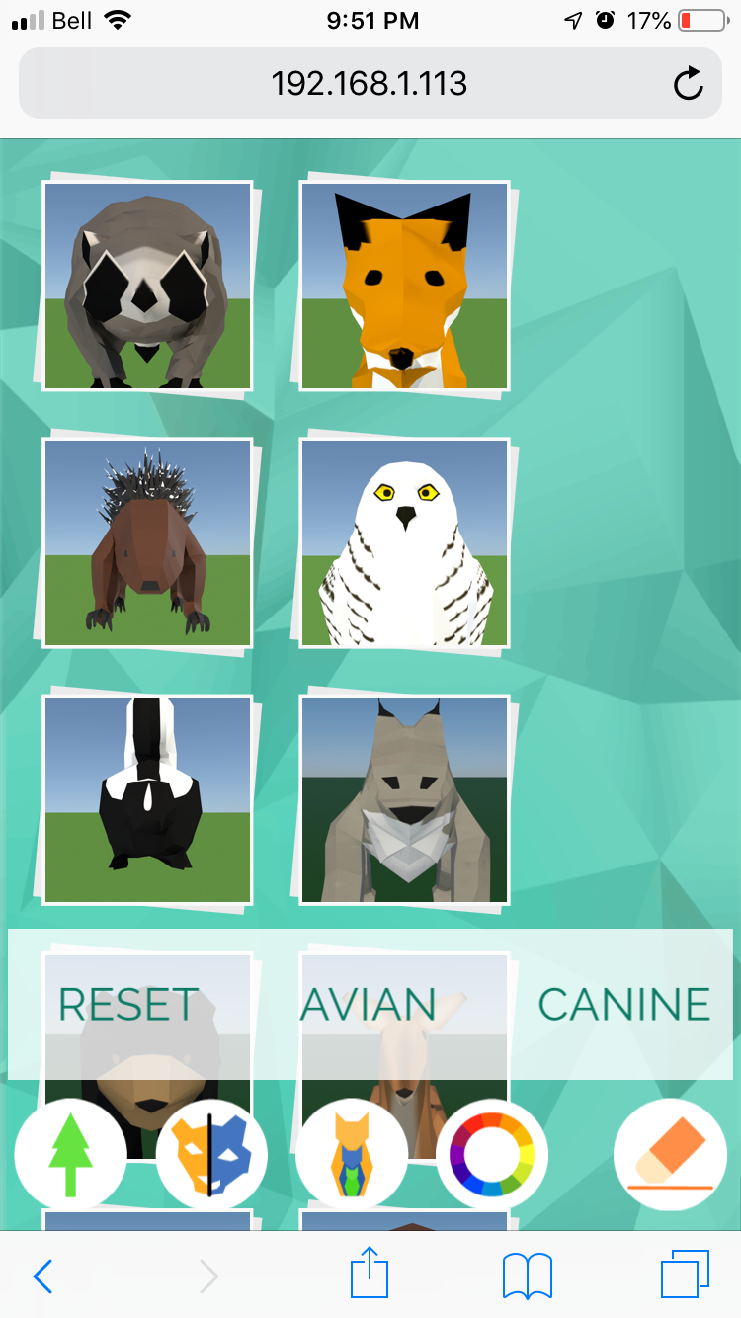
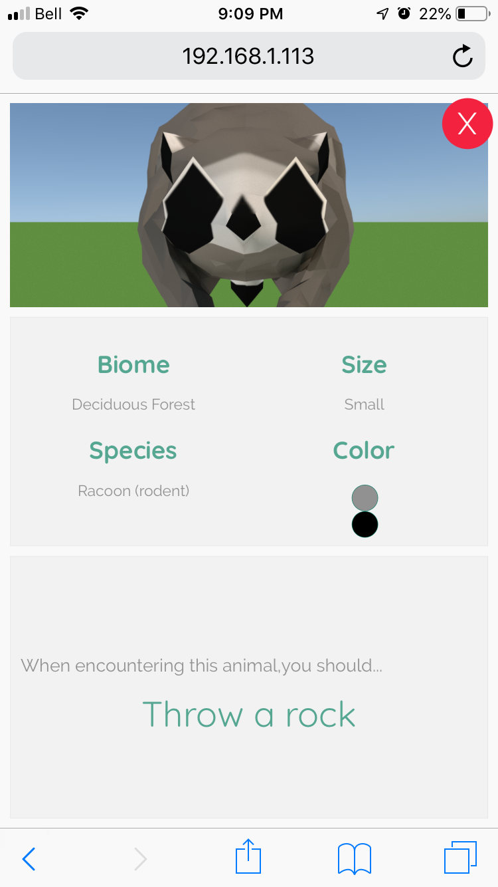
Development
Guidebook – Then vs Now

Slide 14
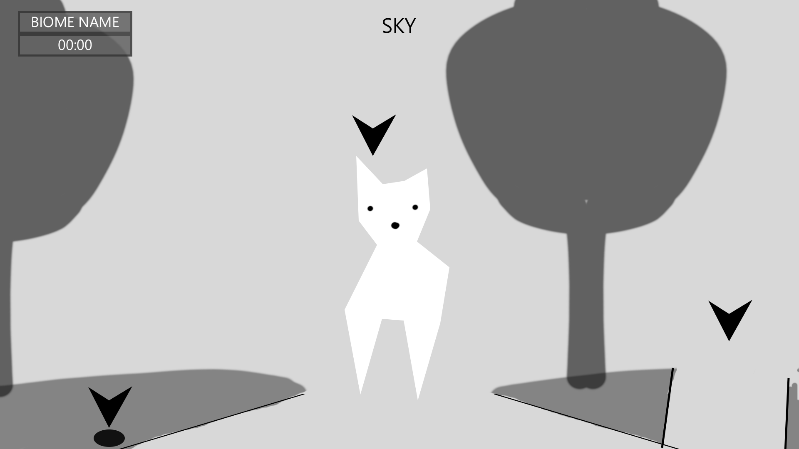
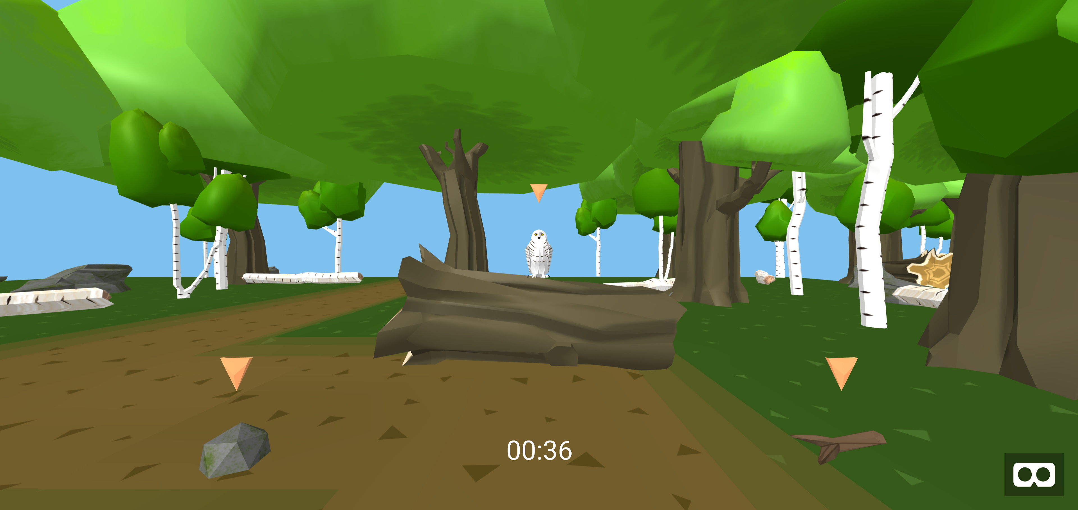
Development
Hiking Screen – Then vs Now

Slide 15
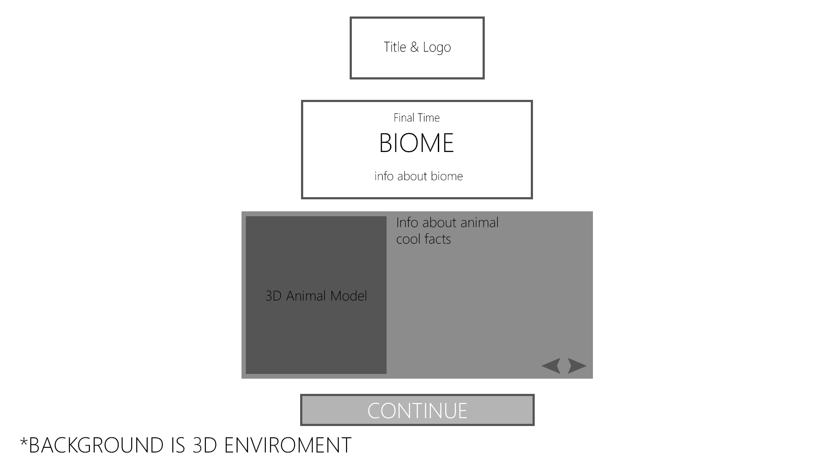
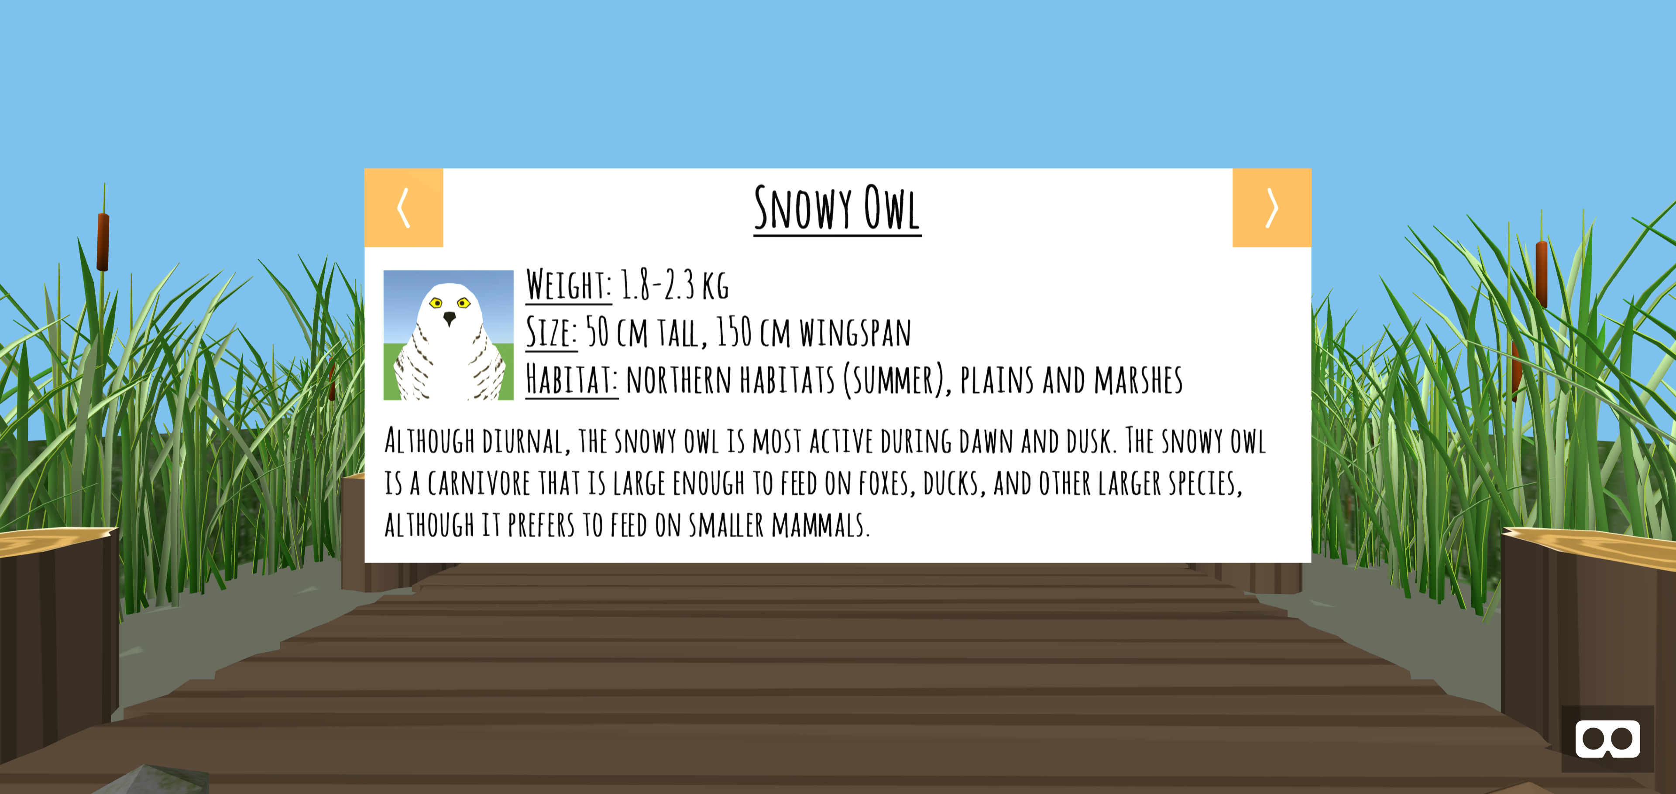
Development
Completion/Game Over – Then vs Now

Slide 16
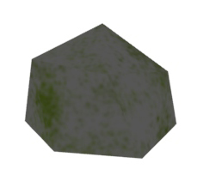

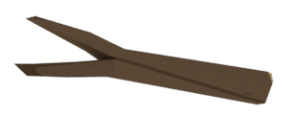
Assets
Action Items

Slide 17
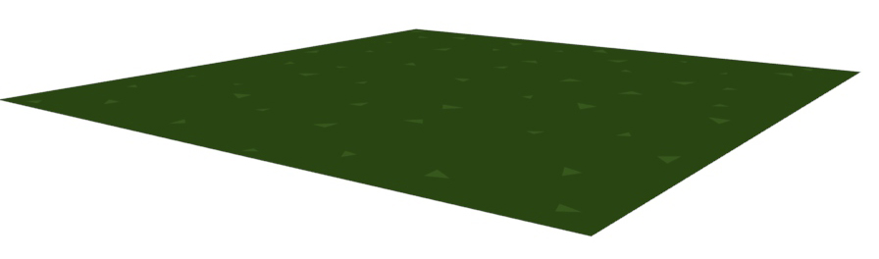
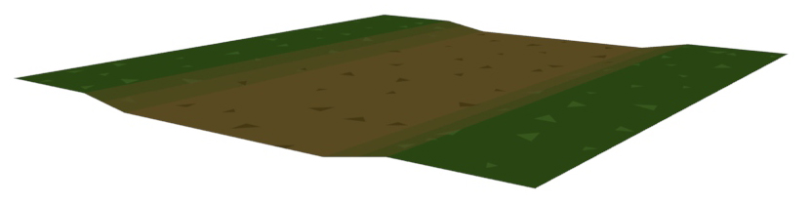
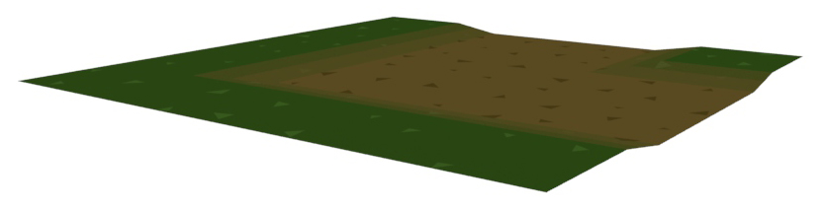
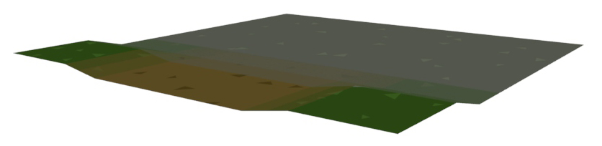
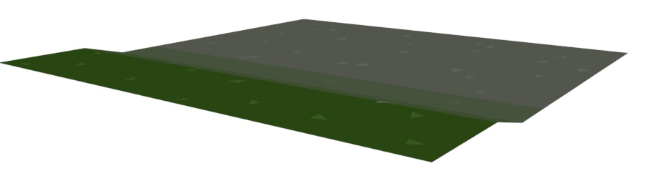
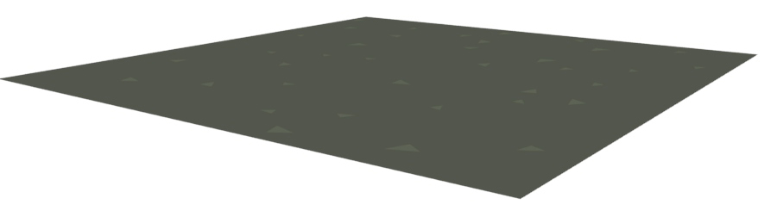
Assets
Path Tiles

Slide 18
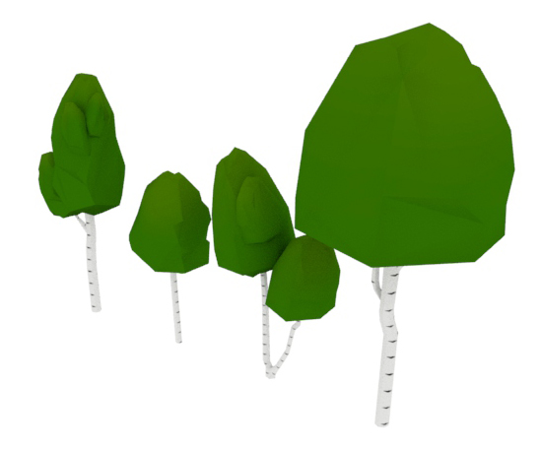
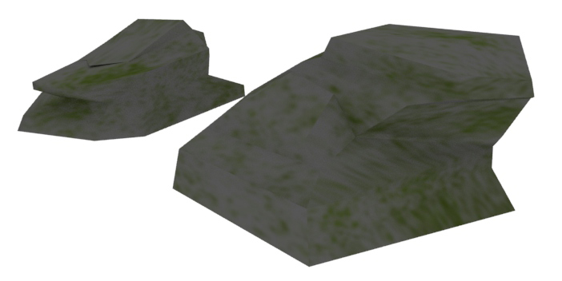
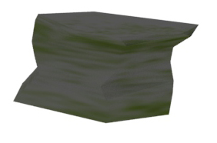
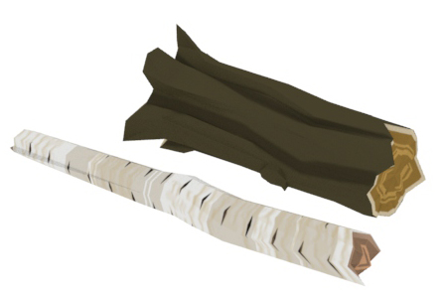
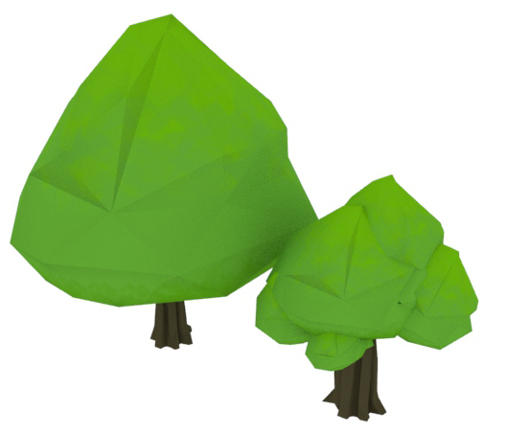
Assets
Deciduous Biome – Environment Pieces

Slide 19
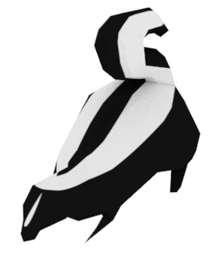
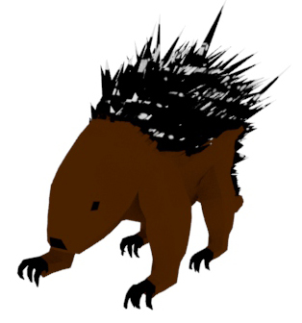
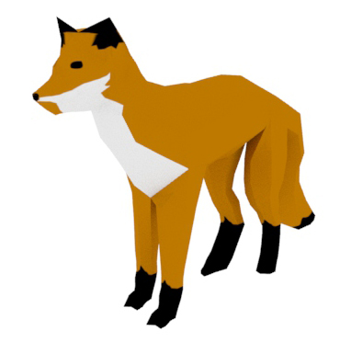
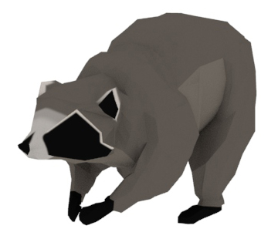
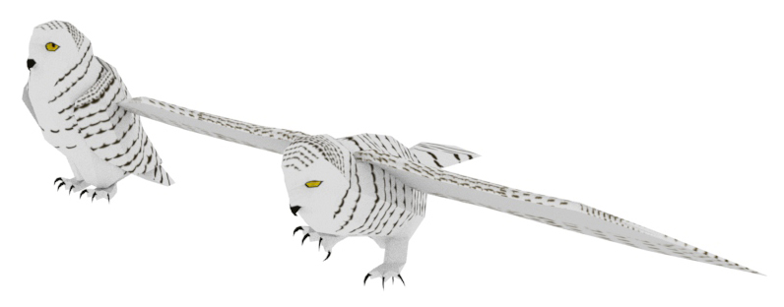
Assets
Deciduous Biome – Animals

Slide 20
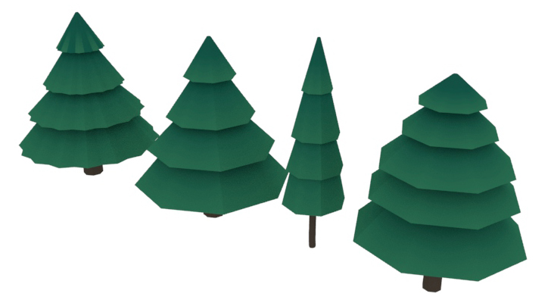
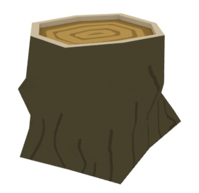
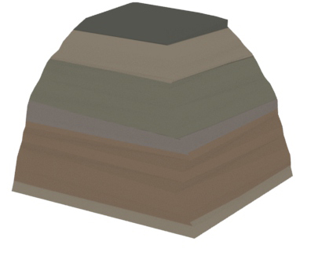
Assets
Boreal Biome – Environment Pieces

Slide 21
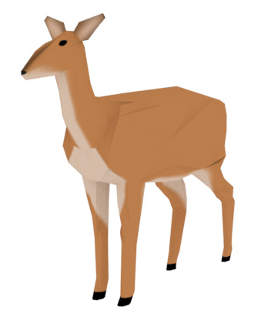
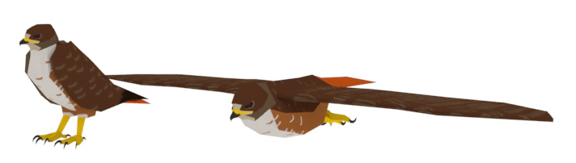
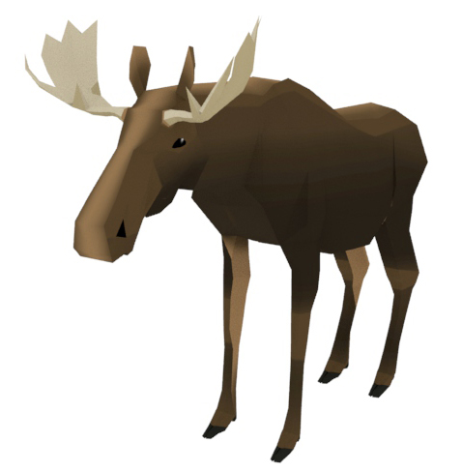
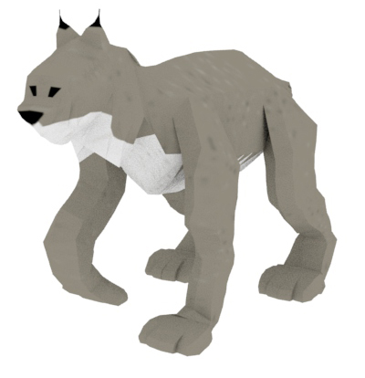
Assets
Boreal Biome – Animals

Slide 22
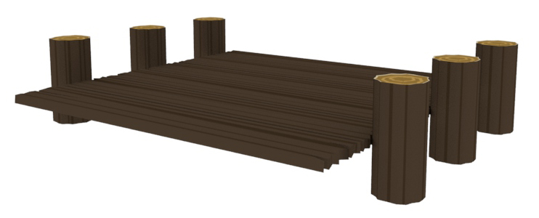
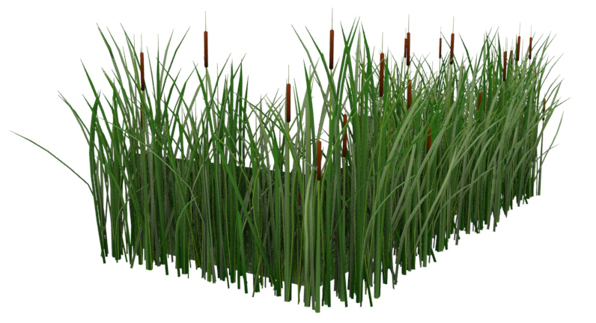
Assets
Wetlands Biome – Environment Pieces

Slide 23
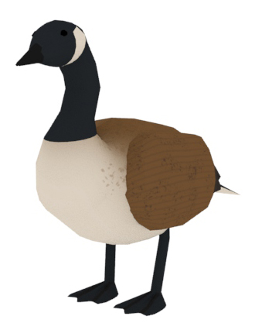
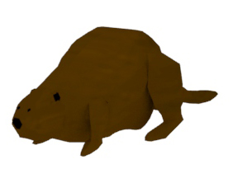
Assets
Wetlands Biome – Animals

Slide 24
Demonstation
10.50.51.98:8080

